Slide 1
Zee Brain
Chapter 1
Notes:
Behavioral Neuroscience
©2001 Prentice Hall

Slide 2
Why the Brain?
Turning to the brain helps us to grapple with the challenge of identifiability.
Identifiability refers to the ability to specify the correct combination of representations and processes used to accomplish a task.
Facts about the brain can help us test the adequacy of a theory, which lets us know whether a theory is—to that point—valid.
Chapter 1

Slide 3
The Cognitive Brain
Neurons: The Building Blocks of the Brain
Structure of the Nervous System
The Peripheral Nervous System
The Cerebral Cortex
Subcortical Areas
Chapter 1

Slide 4
The Neuron
So, why do we care about neurons?
Notes:
Behavioral Neuroscience
©2001 Prentice Hall
Section outline

Slide 5
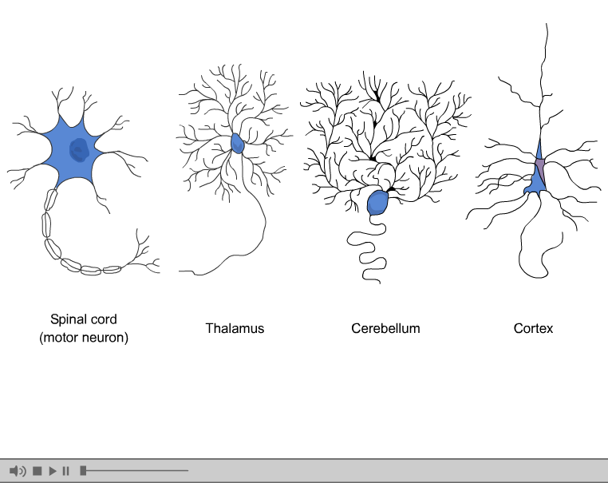
Chapter 1

Slide 6
Neurons
Types
Parts
Communication
  Mexican Wave
  Neurotransmitters
Notes:
Behavioral Neuroscience
©2001 Prentice Hall
It’s how we think!
Drugs
Memories
etc

Slide 7
Types
Sensory
  Activated by the sense organs
Motor
  Activated by movement
Interneurons
  Things that connect the first two

Slide 8
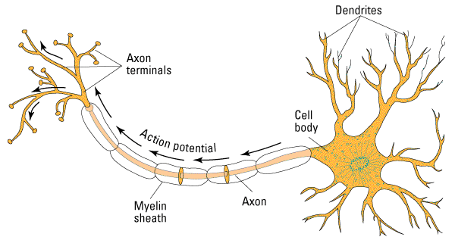
Structure of a Neuron
Notes:
Behavioral Neuroscience
©2001 Prentice Hall

Slide 9
Parts
Dendrites
Cell Body
Axon
Myelin
Terminal Buttons
Synapse

Slide 10
Extra Parts
Glial Cells
Receptors
Neurotransmitters

Slide 11
The Mexican Wave
Inter-neuron communication
http://youtube.com/watch?v=TQ7NIvXEpVY
  3:44

Slide 12
The Neuron in Action
Electro-chemical process
Action Potential
  Electrical impulse
  Caused by influx of positive ions
Threshold
Notes:
Behavioral Neuroscience
©2001 Prentice Hall
Action Potential
An electrical impulse that surges along an axon, caused by an influx of positive ions in the neuron
Threshold
The level of stimulation needed to trigger an action potential

Slide 13
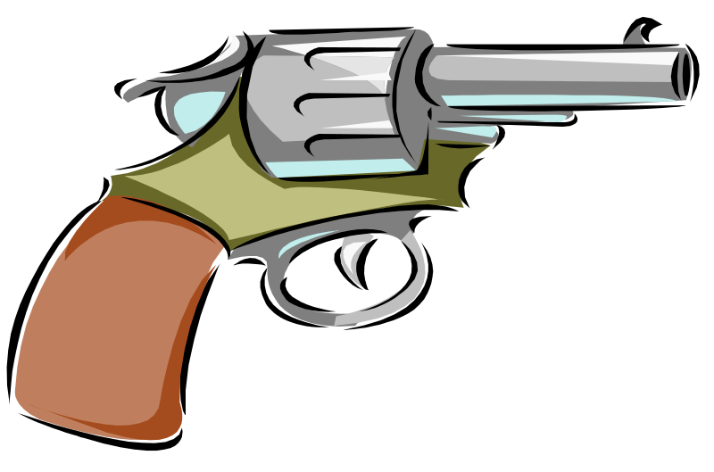
Neurons: All or None Response
Neurons either “fire” an action potential or they do not
  No halfway responses
Notes:
Behavioral Neuroscience
©2001 Prentice Hall

Slide 14
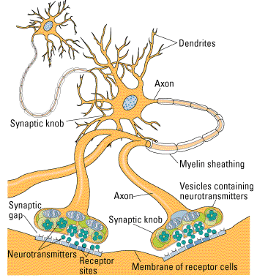
How Neurons Communicate
Between neuron communication
Axon terminals release neurotransmitter into the synapse
Neurotransmitter binds to receptors that it fits
Notes:
Behavioral Neuroscience
©2001 Prentice Hall
Figure 2.7 from:
Kassin, S. (2001). Psychology, third edition. Upper Saddle River, NJ: Prentice Hall.
Source:

Slide 15
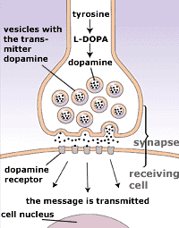

Neurotransmitters
Serotonin
Dopamine
Epinephrine
Endorphins
Hormones
Notes:
Behavioral Neuroscience
©2001 Prentice Hall

Slide 16
The Brain
Nervous System
Parts of the Brain
Studying the Brain
Notes:
Behavioral Neuroscience
©2001 Prentice Hall
Section outline

Slide 17
Nervous System
Peripheral Nervous System
Central Nervous System
Notes:
Behavioral Neuroscience
©2001 Prentice Hall
Does neat stuff, but we don’t care right now.

Slide 18
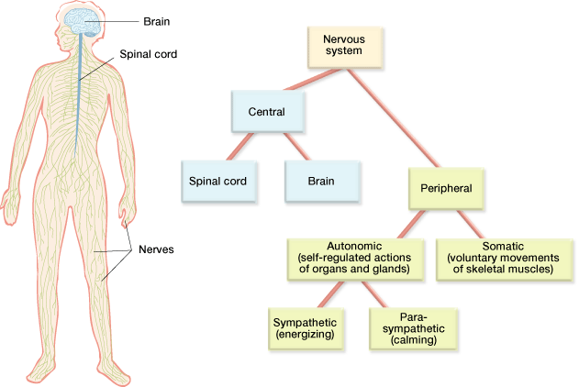
Structure of the Nervous System
Chapter 1
Notes:
The nervous system is traditionally considered to have two major parts, the central nervous system (CNS) and the peripheral nervous system (PNS). The CNS consists of the brain and spinal cord; the PNS consists of the skeletal nervous system and the autonomic nervous system (ANS). We start with the more basic, and (in evolution­ary terms) older PNS and then turn to the brain itself. (p. 18)

Slide 19
Zee Brain Parts

Slide 20
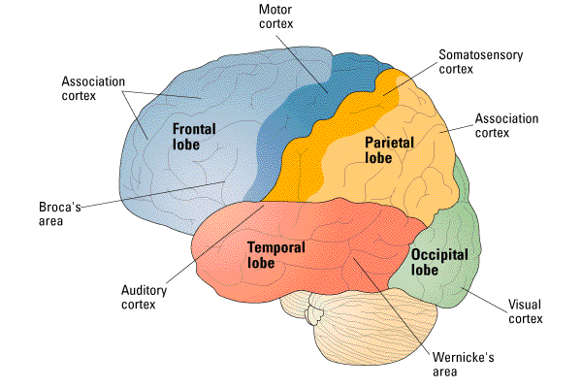
Lobes of the Cerebral Cortex
Notes:
Behavioral Neuroscience
©2001 Prentice Hall
Figure 2.16 from:
Kassin, S. (2001). Psychology, third edition. Upper Saddle River, NJ: Prentice Hall.
Source:.

Slide 21
Frontal Lobes
Primary Motor Cortex (posterior)
Prefrontal Cortex (PFC; anterior)
Broca’s
Functions:
Abstract Thinking
Attention
Speech Production

Slide 22
Parietal Lobes
Primary somatosensory area
Spatial processing
Memory management
  Search & retrieval (Long Term Memory)
  Storage

Slide 23
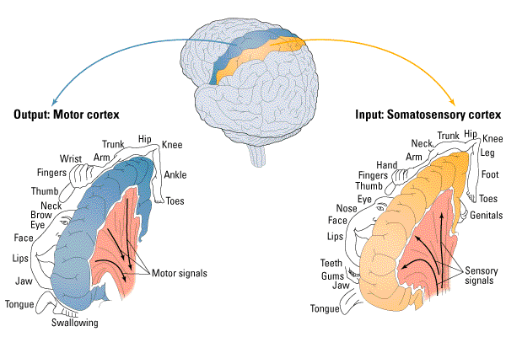
Notes:
Behavioral Neuroscience
©2001 Prentice Hall
Figure 2.17 from:
Kassin, S. (2001). Psychology, third edition. Upper Saddle River, NJ: Prentice Hall.
Source:

Slide 24
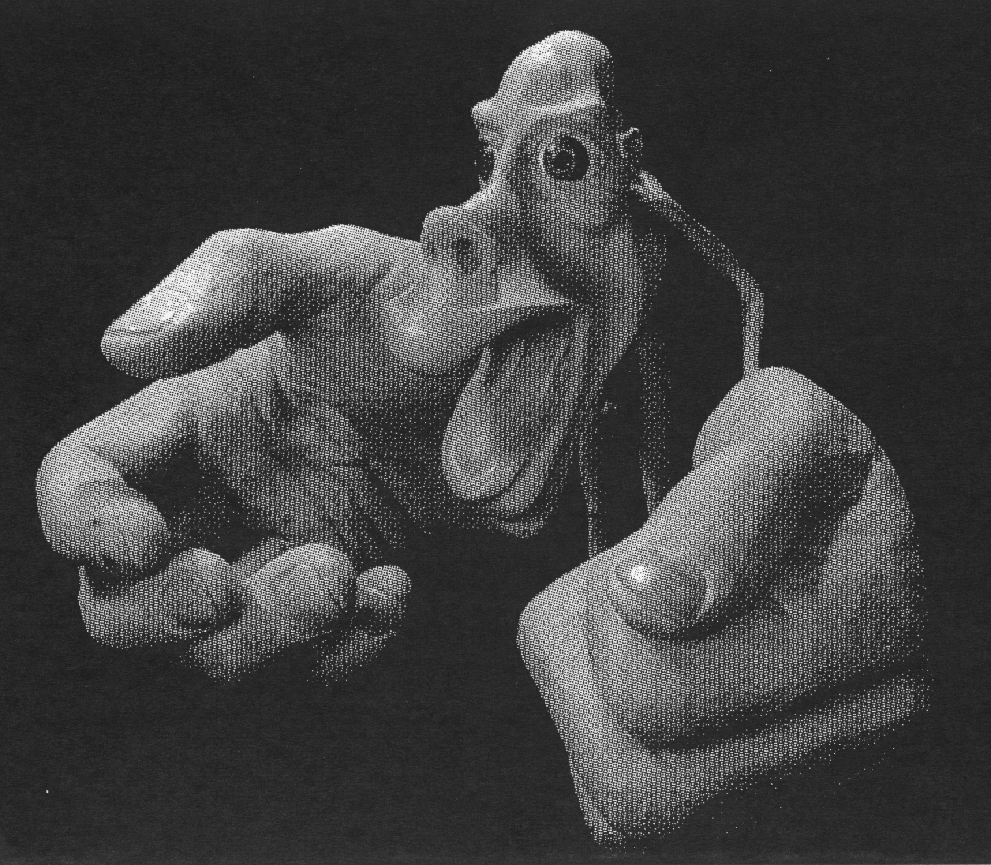


Slide 25
Occipital Lobes
All things visual.
  Seeing, attention, etc.
Cross-over.

Slide 26
Temporal Lobes
All things hearing (auditory cortex)
Wernicke’s
Face recognition
  Fusiform Gyrus
Memory
  Connected to hippocampus

Slide 27
Sub-cortical Areas
Do what?
  Areas below the cortex where all the lobes are.
The important few:
  Hippocampus - memory
  Amygdala - emotion

Slide 28
Back up a second…
Aren’t there two sides?
  Left and Right Hemispheres
Both sides have these lobes and sub-cortical regions.
  But they tend to specialize.

Slide 29
Cross talk?
How do the two sides say hi?
  Especially since the left side of your body is controlled by the right side of your brain.
  And vice versa.

Slide 30
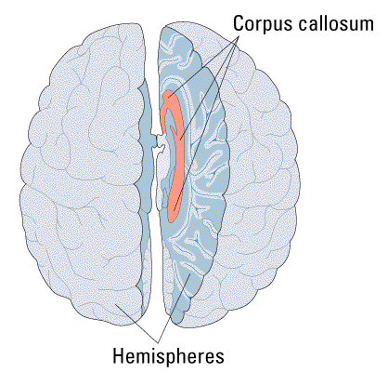
The Corpus Callosum
Millions of myelinated axons
Pathway for communication
If severed (epilepsy), what happens?
Notes:
Behavioral Neuroscience
©2001 Prentice Hall
Figure 2.20 from:
Kassin, S. (2001). Psychology, third edition. Upper Saddle River, NJ: Prentice Hall.
Source:

Slide 31
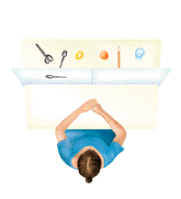
Sperry’s Split-Brain Experiment
Split-brain subjects could not name objects shown only to the right hemisphere
Why?
  Left = Language = Speech.
  The left said couldn’t tell your brain to say SPOON.
  But the Right side could tell the left side to pick up the spoon.
Notes:
Behavioral Neuroscience
©2001 Prentice Hall
Figure 2.22 from:
Kassin, S. (2001). Psychology, third edition. Upper Saddle River, NJ: Prentice Hall.
Source:
Sperry, R. W. (1968). Hemisphere deconnection and unity in conscious awareness. American Psychologist, 23, 723-733.

Slide 32
Summary
Neurons > have special mechanisms to transmit information.
Areas of the brain (lobes) are groups of neurons that do specific things.
Hemispheres are the two halves of the brain (mirrored).
Why study this? (next notes!).

